Slide 1
Unsupervised Learning
Many of the learning algorithms that we have seen have made use of a training set that consists of a collection of labelled target data, or at least (for evolutionary and reinforcement learning) some scoring system that identifies whether or not a prediction is good or not.
Targets are obviously useful, since they enable us to show the algorithm the correct answer to possible inputs, but in many circumstances they are difficult to obtain— they could, for instance, involve somebody labelling each instance by hand.
In addition, most of the time when we are learning, we don’t get told exactly what the right answer should be.
Here, where there is no information about the correct outputs available at all, and the algorithm is left to spot some similarity between different inputs for itself.
Unsupervised learning is a conceptually different problem to supervised learning.
1

Slide 2
Obviously, we can’t hope to perform regression: we don’t know the outputs for any points, so we can’t guess what the function is.
Can we hope to do classification then? The aim of classification is to identify similarities between inputs that belong to the same class.
There isn’t any information about the correct classes, but if the algorithm can exploit similarities between inputs in order to cluster inputs that are similar together, this might perform classification automatically.
So the aim of unsupervised learning is to find clusters of similar inputs in the data without being explicitly told that these data points belong to one class and those to a different class.
Instead, the algorithm has to discover the similarities for itself.
The supervised learning algorithms that we have discussed so far have aimed to minimize some external error criterion—mostly the sum-of-squares error—based on the difference between the targets and the outputs.

Slide 3
Calculating and minimising this error was possible because we had target data to calculate it from, which is not true for unsupervised learning.
This means that we need to find something else to drive the learning.
The problem is more general than sum-of-squares error: we can’t use any error criterion that relies on targets or other outside information (an external error criterion), we need to find something internal to the algorithm.
This means that the measure has to be independent of the task, because we can’t keep on changing the whole algorithm every time a new task is introduced.
In supervised learning the error criterion was task-specific, because it was based on the target data that we provided.
Then inputs that are close together are identified as being similar, so that they can be clustered, while inputs that are far apart are not clustered together.

Slide 4
We can extend this to the nodes of a network by aligning weight space with input space.
Now if the weight values of a node are similar to the elements of an input vector then that node should be a good match for the input, and any other inputs that are similar.
K-Means Algorithm
Suppose that we want to divide our input data into k categories, where we know the value of k (for example, we have a set of medical test results from lots of people for three diseases, and we want to see how well the tests identify the three diseases).
We allocate k cluster centres to our input space, and we would like to position these centres so that there is one cluster centre in the middle of each cluster.
However, we don’t know where the clusters are, let alone where their ‘middle’ is, so we need an algorithm that will find them.
Learning algorithms generally try to minimise some sort of error, so we need to think of an error criterion that describes this aim.

Slide 5
There are actually two things that we need to define:
A distance measure In order to talk about distances between points, It is often the normal Euclidean distance, but there are other alternatives;
The mean average Once we have a distance measure, we can compute the central point of a set of data points, which is the mean average
We can now think about a suitable way of positioning the cluster centres: we compute the mean point of each cluster, μc(i), and put the cluster centre there.
This is equivalent to minimising the Euclidean distance (which is the sum-of-squares error again) from each data point to its cluster centre.
How do we decide which points belong to which clusters? It is important to decide, since we will use that to position the cluster centres.
The obvious thing is to associate each point with the cluster centre that it is closest too. This might change as the algorithm iterates,

Slide 6
We start by positioning the cluster centres randomly through the input space, since we don’t know where to put them, and then we update their positions according to the data.
We decide which cluster each data point belongs to by computing the distance between each data point and all of the cluster centres, and assigning it to the cluster that is the closest.
For all of the points that are assigned to a cluster, we then compute the mean of them, and move the cluster centre to that place.
We iterate the algorithm until the cluster centres stop moving.

Slide 7
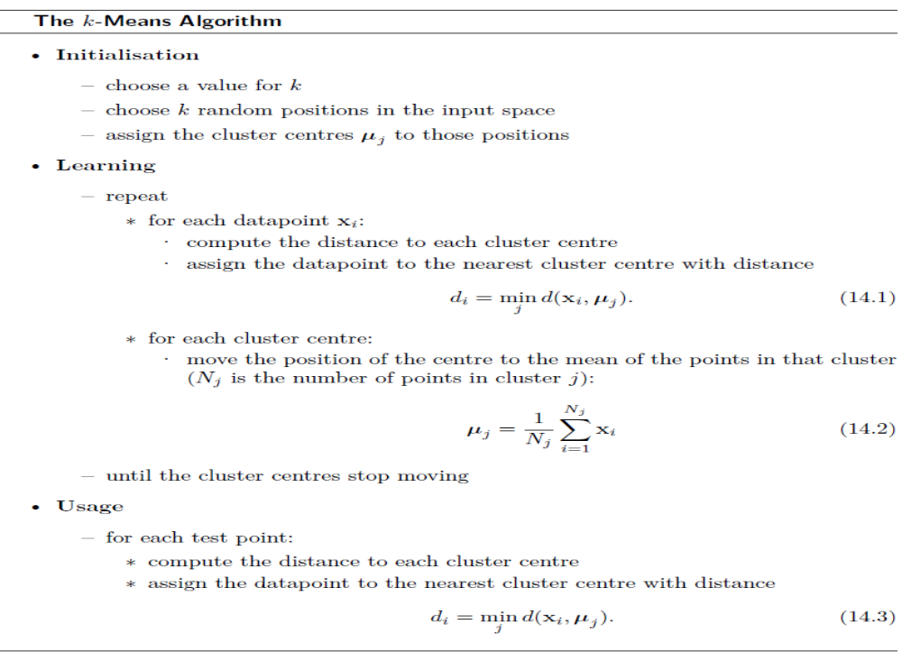

Slide 8
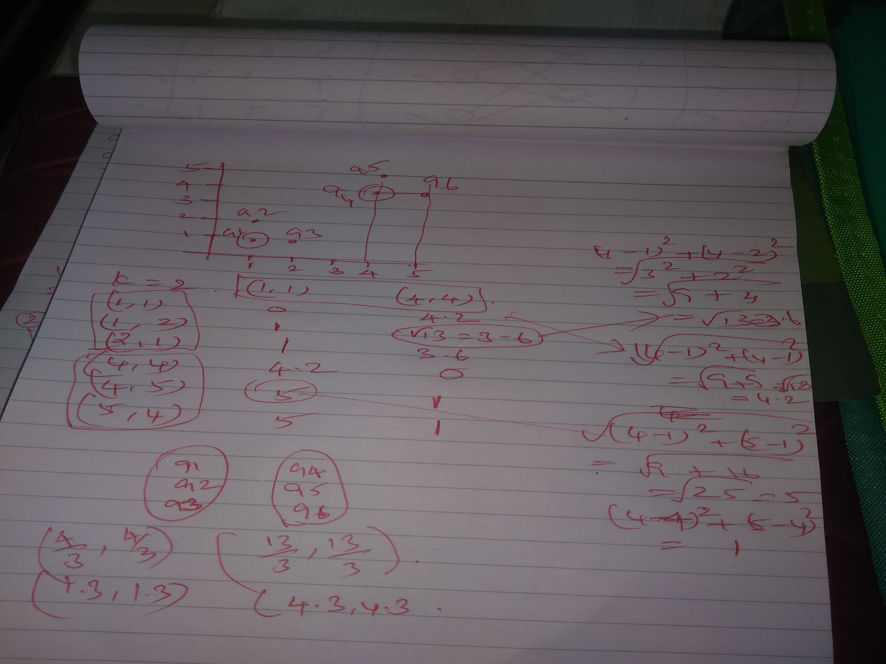

Slide 9
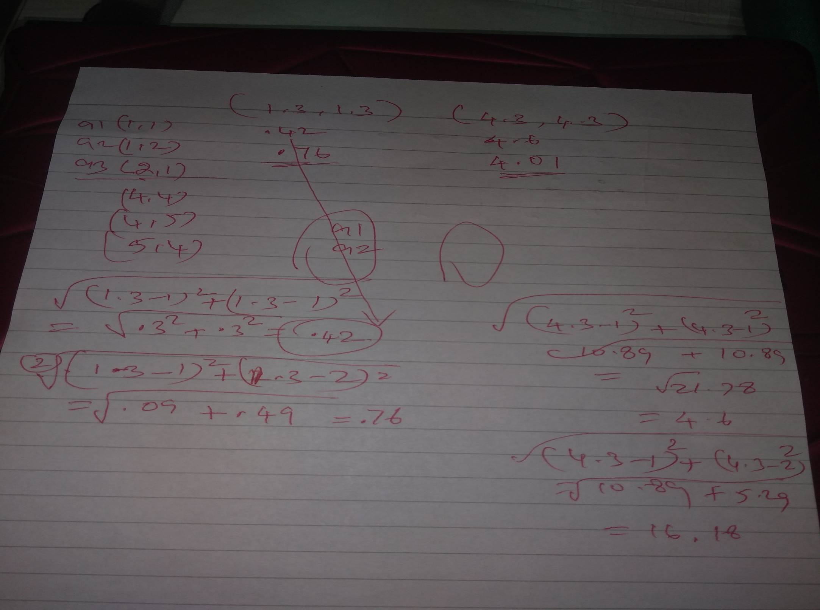

Slide 10
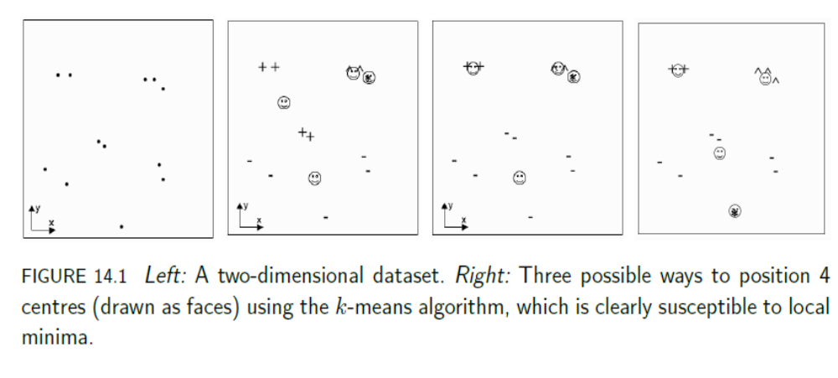
Figures 14.1 and 14.2 show some data and some different ways to cluster that data computed by the k-means algorithm.
It should be clear that the algorithm is susceptible to local minima: depending upon where the centres are initially positioned in the space, you can get very different solutions

Slide 11
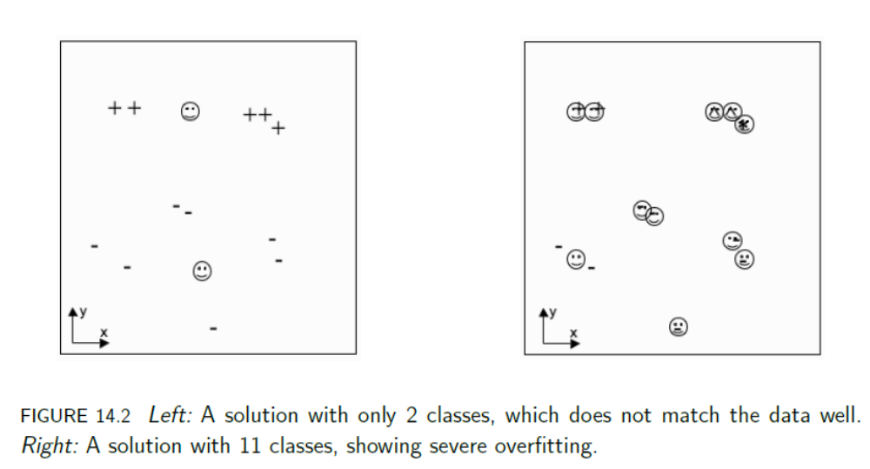
Figure 14.2 shows examples of what happens when you choose the number of centres wrongly.
There are certainly cases where we don’t know in advance how many clusters we will see in the data, but the k-means algorithm doesn’t deal with this at all well.

Slide 12
To find a good local optimum (or even the global one) we use many different initial centre locations, and find the solution that minimises the overall sum-of-squares error is likely to be the best one.
By running the algorithm with lots of different values of k, we can see which values give us the best solution.
If we still just measure the sum-of-squares error between each data point and its nearest cluster centre, then when we set k to be equal to the number of data points, we can position one centre on every data point, and the sum-of-squares error will be zero
However, there is no generalisation in this solution: it is a case of serious overfitting.

Slide 13
Dealing with Noise
There are lots of reasons for performing clustering, but one of the more common ones is to deal with noisy data readings.
These might be slightly corrupted, or occasionally just plain wrong.
If we can choose the clusters correctly, then we have effectively removed the noise, because we replace each noisy data point by the cluster centre
Unfortunately, the mean average, which is central to the k-means algorithm, is very susceptible to outliers, i.e., very noisy measurements.
One way to avoid the problem is to replace the mean average with the median, which is what is known as a robust statistic, meaning that it is not affected by outliers (the mean of (1, 2, 1, 2, 100) is 21.2, while the median is 2).
The only change that is needed to the algorithm is to replace the computation of the mean with the computation of the median.
This is computationally expensive, but does remove noise effectively.

Slide 14
The k-Means Neural Network
If we think about the cluster centres that we optimise the positions of as locations in weight space, then we could position neurons in those places and use neural network training.
The computation that happened in the k-means algorithm was that each input decided which cluster centre it was closest to by calculating the distance to all of the centres.
We could do this inside a neural network, too: the location of each neuron is its position in weight space, which matches the values of its weights.
So for each input, we make the activation of a node be the distance between that node in weight space and the current input.
So, we can implement the k-means algorithm using a set of neurons.
We will use just one layer of neurons, together with some input nodes, and no bias node.
The first layer will be the inputs, which don’t do any computation, as usual.

Slide 15
Second layer will be a layer of competitive neurons, that is, neurons that ‘compete’ to fire, with only one of them actually succeeding.
Only one cluster centre can represent a particular input vector, and so we will choose the neuron with the highest activation h to be the one that fires.
This is known as winner-takes-all activation, and it is an example of competitive learning, since the set of neurons compete with each other to fire, with the winner being the one that best matches (i.e., is closest to) the input.
Competitive learning is sometimes said to lead to grandmother cells, because each neuron in the network will learn to recognise one particular feature, and will fire only when that input is seen.
You would then have a specific neuron that was trained to recognise your grandmother (and others for anybody else/anything else that you see often).
We will choose k neurons (for hopefully obvious reasons) and fully connect the inputs to the neurons, as usual.

Slide 16
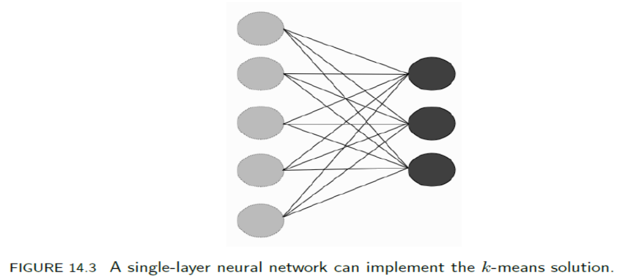
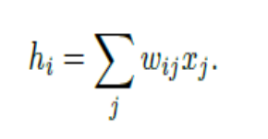
We will use neurons with a linear transfer function, computing the activation of the neurons as simply the product of the weights and inputs:
Providing that the inputs are normalised so that their absolute size is the same, this effectively measures the distance between the input vector and the cluster centre represented by that neuron, with larger numbers (higher activations) meaning that the two points are closer together.
So the winning neuron is the one that is closest to the current input.

Slide 17
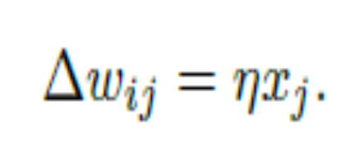
The question is how can we then change the position of that neuron in weight space, that is, how do we update its weights?
In the k-means algorithm that was described earlier it was easy: we just set the cluster centre to be the mean of all the data points that were assigned to that centre.
However, when we do neural network training, we often feed in just one input vector at a time and change the weights (that is, we use the algorithm on-line, rather than batch).
We therefore do not know the mean because we don’t know about all the data points, just the current one.
So we approximate it by moving the winning neuron closer to the current input, making that centre even more likely to be the best match next time that input is seen.
This corresponds to:

Slide 18
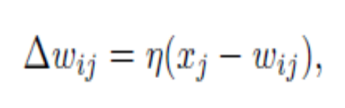
A Better Weight Update Rule
The weight update rule given in Equation (14.5) lets the weights grow without any bound, so that they do not lie on the unit hypersphere any more.
If we normalise the inputs as well, which certainly seems reasonable, then we can use the following weight update rule:
which has the effect of moving the weight wij directly towards the current input.
Remember that the only weights that we are updating are those of the winning unit:
Example: The Iris Dataset

Slide 19
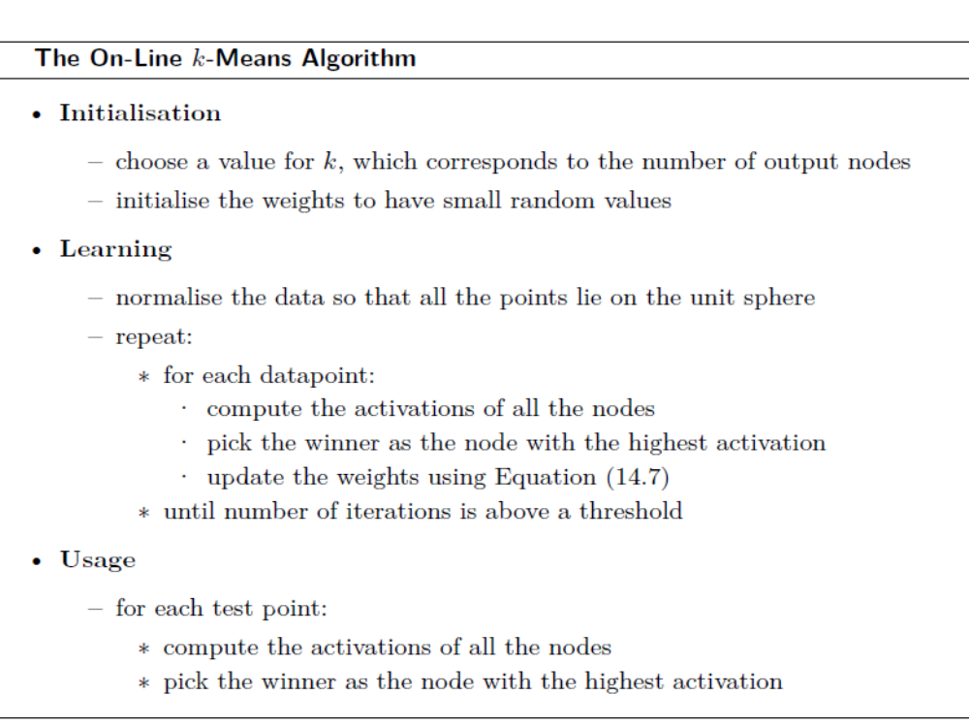

Slide 20
VECTOR QUANTISATION
We’ve already discussed using competitive learning for removing noise.
There is a related application, data compression, which is used both for storing data and for the transmission of speech and image data.
The reason that the applications are related is that both replace the current input by the cluster centre that it belongs to.
For noise reduction we do this to replace the noisy input with a cleaner one, while for data compression we do it to reduce the number of data points that we send
Both of these things can be understood by considering them as examples of data communication.
Suppose that I want to send data to you, but that I have to pay for each data bit I transmit, so I want to keep the amount of data that I send to a minimum.

Slide 21
I notice that there are lots of repeated data points, so I decide to encode my data before I send it, so that instead of sending the entire set, we agree on a codebook of prototype vectors together.
Now, instead of transmitting the actual data, I can transmit the index of that data point in the codebook, which is shorter.
All you have to do is take the indices I send you and look them up, and you have the data.
We can actually make the code even more efficient by using shorter indices for the data points that are more common.
What happens when I want to send a datapoint and it isn’t in the codebook?
In that case we need to accept that our data will not look exactly the same, and I send you the index of the prototype vector that is closest to it (this is known as vector quantisation, and is the way that lossy compression works).
The dots at the centre of each cell are the prototype vectors, and any data point that lies within a cell is represented by the dot.

Slide 22
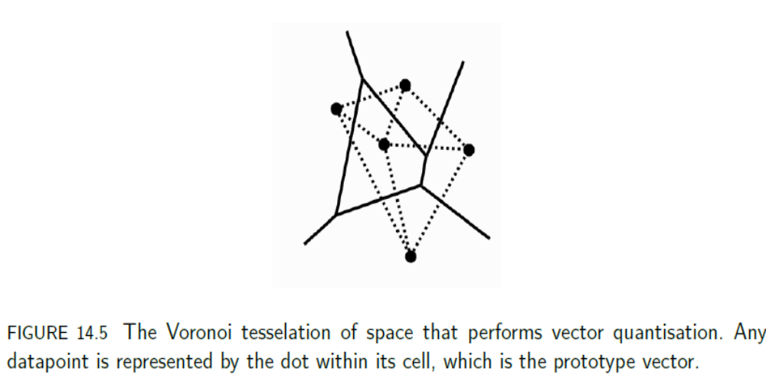
The name for each cell is the Voronoi set of a particular prototype.
Together, they produce the Voronoi tesselation of the space.
If you connect together every pair of points that share an edge, as is shown by the dotted lines, then you get the Delaunay triangulation, which is the optimal way to organise the space to perform function approximation.

Slide 23
THE SELF-ORGANISING FEATURE MAP
By far the most commonly used competitive learning algorithm is the Self-Organising Feature Map (often abbreviated to SOM), which was proposed by Teuvo Kohonen in 1988.
Kohonen was considering the question of how sensory signals get mapped into the cerebral cortex of the brain with an order.
For example, in the auditory cortex, which deals with the sounds that we hear, neurons that are excited (i.e., that are caused to fire) by similar sounds are positioned closely together, whereas two neurons that are excited by very different sounds will be far apart.
The relative locations of the neurons in the network matters (this property is known as feature mapping—nearby neurons correspond to similar input patterns),
and secondly, the neurons are arranged in a grid with connections between the neurons, rather than in layers with connections only between the different layers.

Slide 24
In the auditory cortex there appears to be sheets of neurons arranged in 2D, and that is the typical arrangement of neurons for the SOM: a grid of neurons arranged in 2D, as can be seen in Figure 14.6.
In mathematical terms, the SOM demonstrates relative ordering preservation, which is sometimes known as topology preservation.
The relative ordering of the inputs should be preserved by the ordering in the neurons, so that neurons that are close together represent inputs that are close together, while neurons that are far apart represent inputs that are far apart.
where mismatches between the topology of the input space and map lead to changes in the relative ordering. The best that can be said is that SOM is perfectly topology-preserving, which means that if the dimensionality of the input and the map correspond, then the topology of the input space will be preserved.

Slide 25
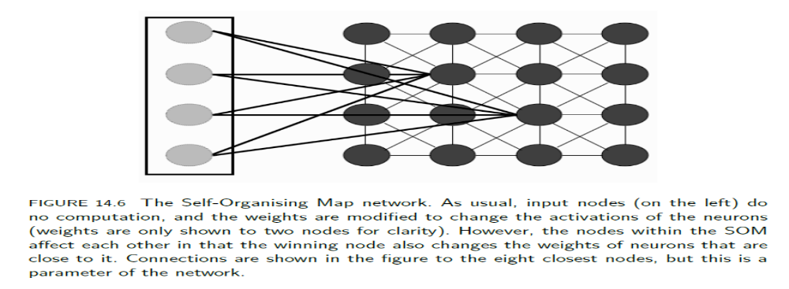
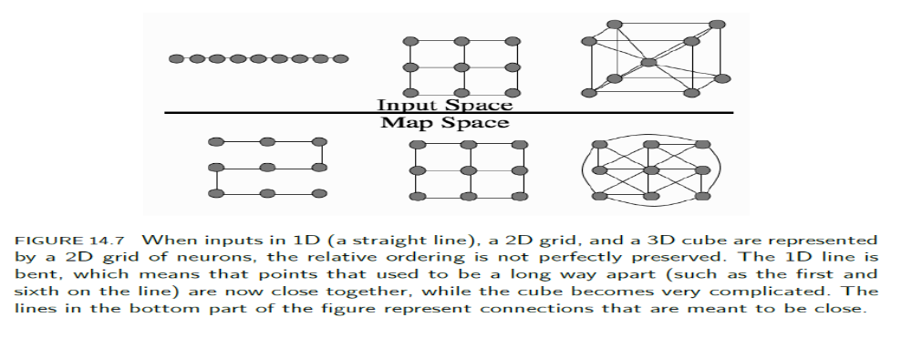

Slide 26
We are trying to introduce feature mapping, so neurons that are close together in the map should represent similar features.
This means that the winning neuron should pull other neurons that are close to it in the network closer to itself in weight space, which means that we need positive connections.
Likewise, neurons that are further away should represent different features, and so should be a long way off in weight space, so the winning neuron ‘repels’ them, by using negative connections to push them away.

Slide 27
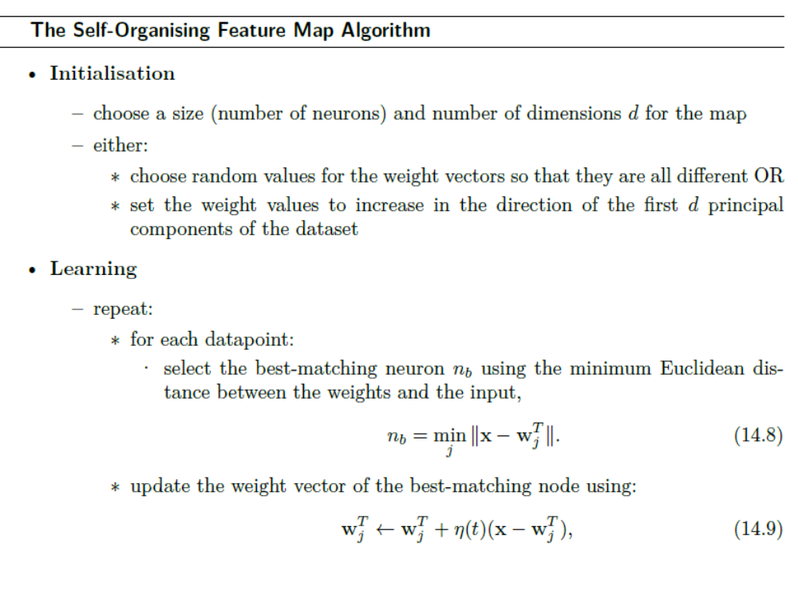

Slide 28
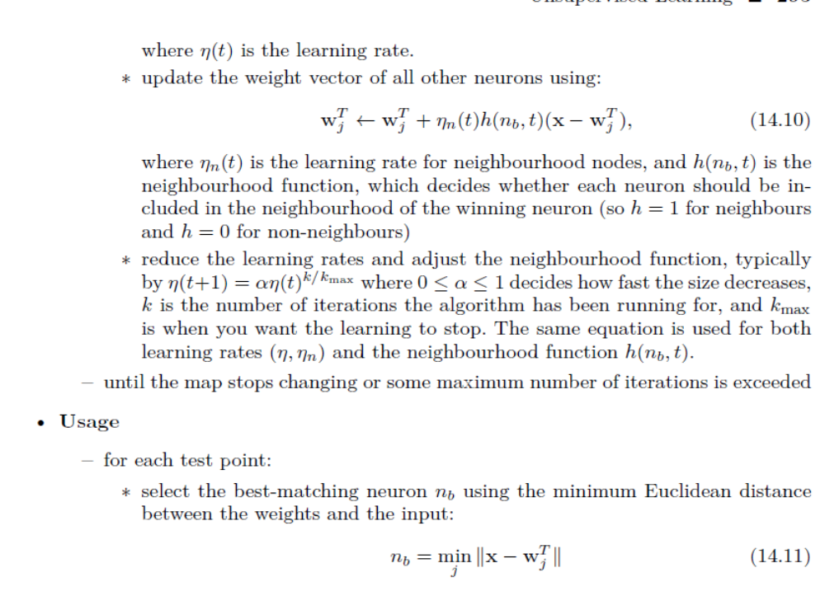

Slide 29
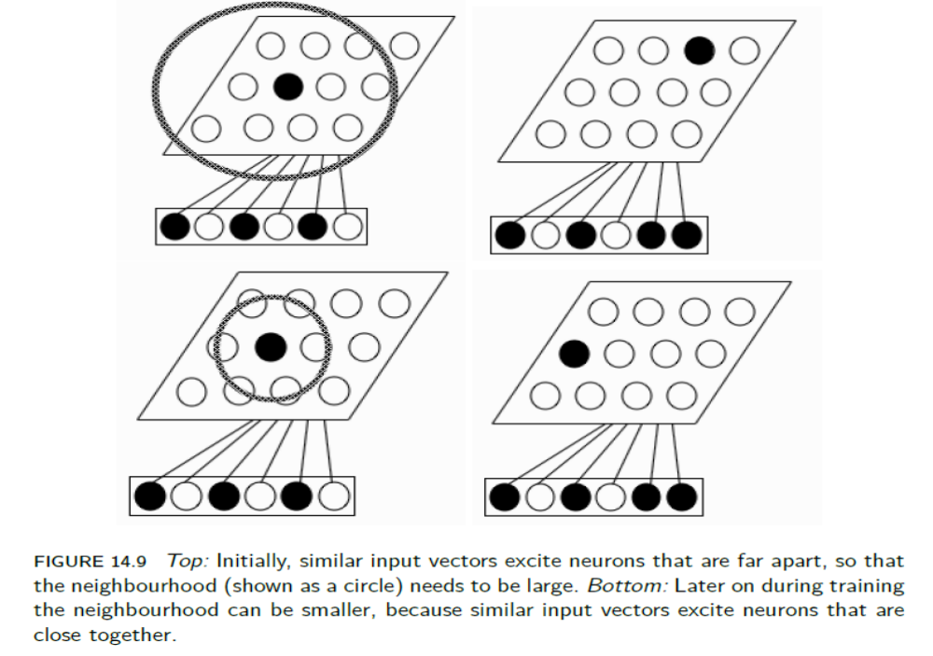
Neighbourhood Connections

Slide 30
Self-Organisation
A particularly interesting aspect of feature mapping is that we get a global ordering of the neurons in the network, despite the fact that the interactions are all local, since neurons that are very far apart do not interact with each other.
We thus get a global ordering of the space using only a set of local interactions, which is amazing. This is known as self-organization
Network Dimensionality and Boundary Conditions
We typically think about applying the SOM algorithm to a 2D rectangular array of neurons
Noise and other inaccuracies in data often lead to it being represented in more dimensions than are actually required, and so finding the intrinsic dimensionality can help to reduce the noise.
We can do this by removing the boundary by tying the ends together.
In 1D this means that we turn a line into a circle, while in 2D we turn a rectangle into a torus.

Slide 31
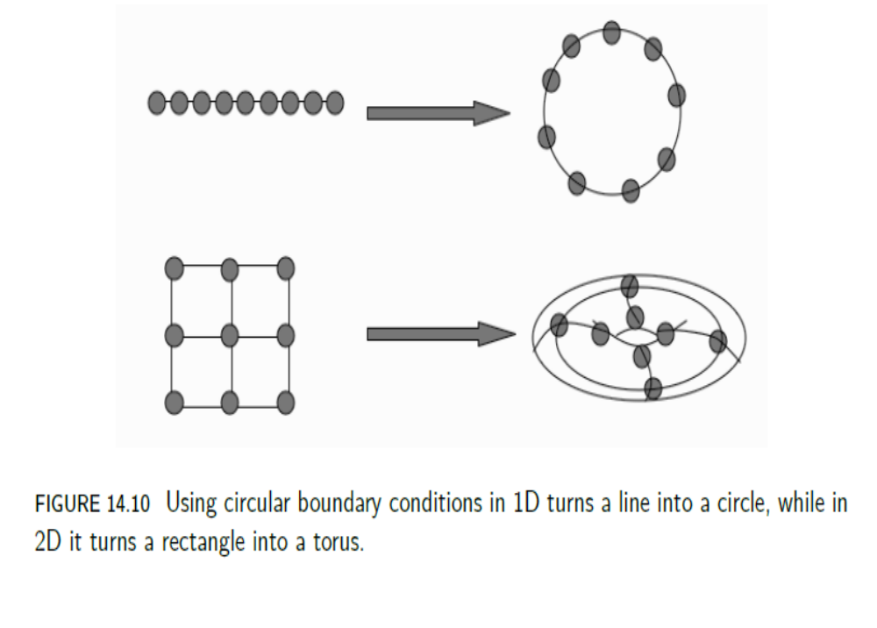
It means that there are no neurons on the edge of the feature map.
The choice of the number of dimensions and the boundary conditions depends on the problem that we are considering, but it is usually the case that the torus works better than the rectangle, although it is not always clear why.

Slide 32
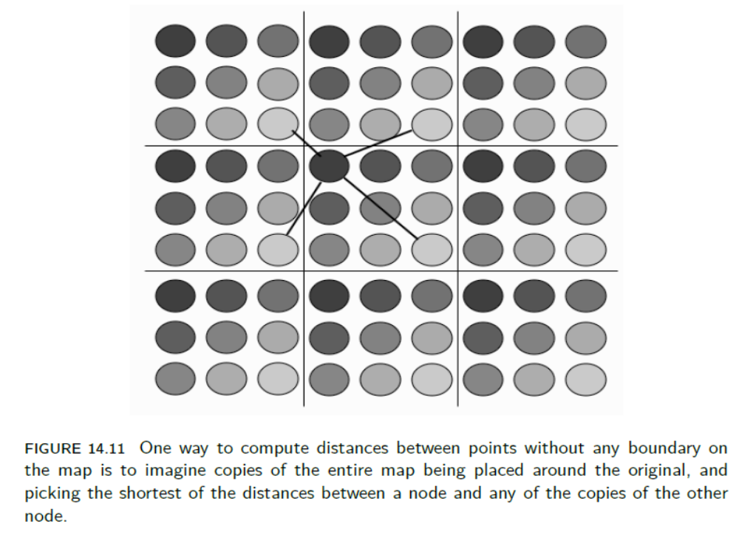

Slide 33
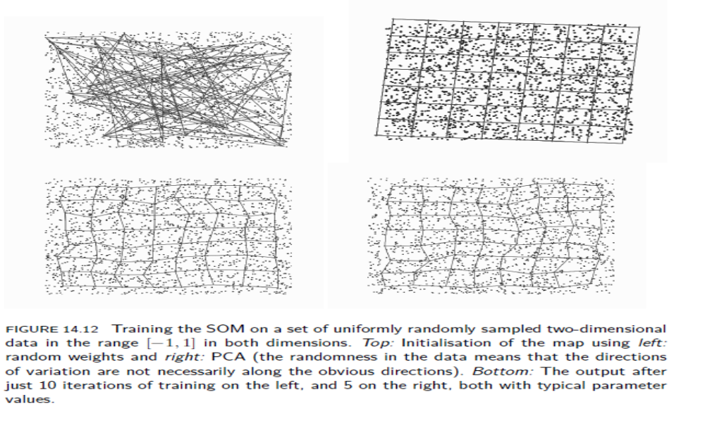
example

Slide 34
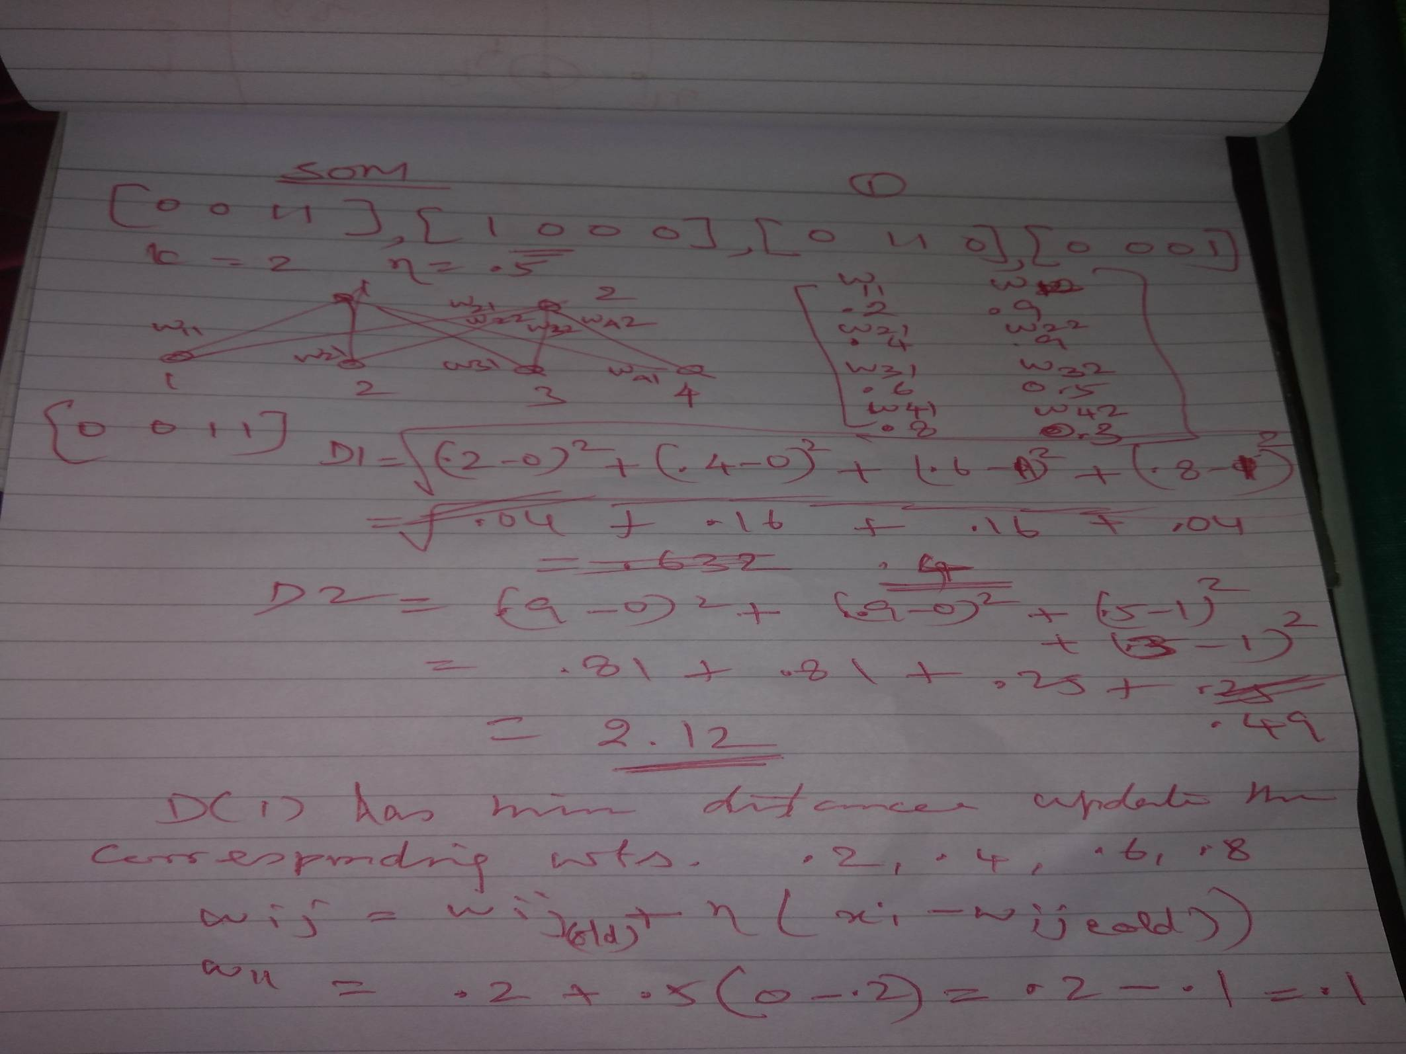

Slide 35
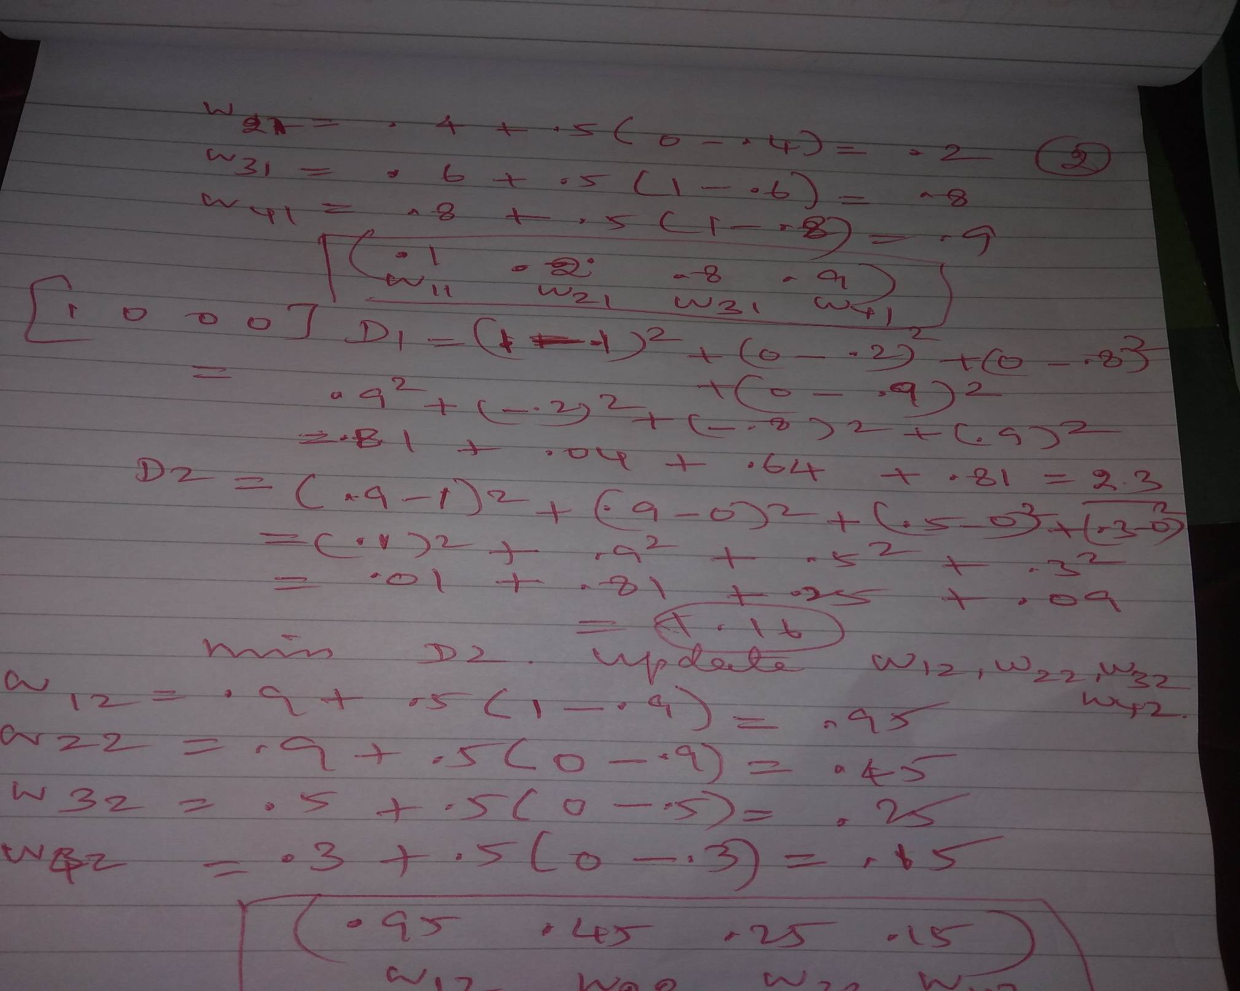

Slide 36
